Slide 1
Intrusion Detection System using Machine Learning By Alagu Shruthi 231210011

Slide 2
TABLE OF CONTENTS
Introduction
Literature Review
01
02
Dataset used
Methodology
03
04
Here you could describe the topic of this section
Here you could describe the topic of this section
Here you could describe the topic of this section
Here you could describe the topic of this section
Result and Discussion
Conclusion
05
06
Here you could describe the topic of this section
Here you could describe the topic of this section

Slide 3


Introduction
Network security is a critical concern as organizations face increasing numbers of sophisticated cyber threats. Intrusion Detection Systems (IDS) provide a vital layer of defense by monitoring network traffic and promptly identifying suspicious activities or attacks. This project explores the development and evaluation of machine learning-based IDS, focusing on efficiently detecting both normal and malicious network activities. By leveraging advanced classification techniques and real-time visualization, the proposed IDS aims to ensure robust protection and immediate response against evolving cyber threats.

Slide 4
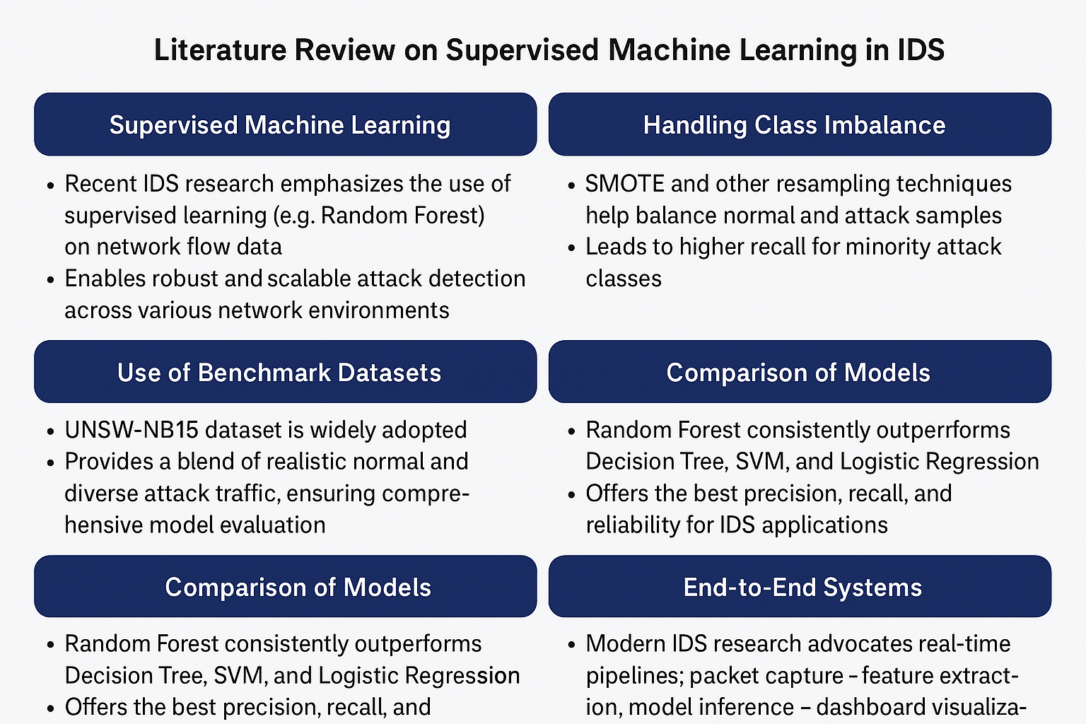
Literature Review

Slide 5
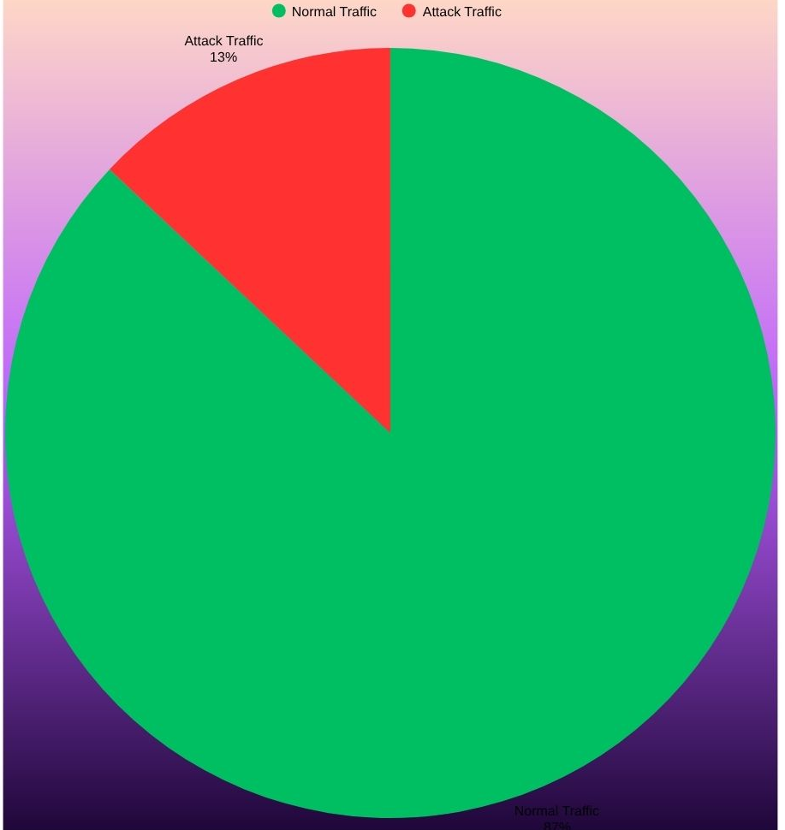
Dataset used
The project utilizes the UNSW-NB15 dataset, developed by the Australian Centre for Cyber Security (ACCS), which is widely recognized for evaluating intrusion detection systems. The dataset contains over 2 million network flow records representing both benign and malicious traffic. Each record is described by 49 features, including flow duration, byte counts, packet statistics, and protocol-related parameters.
The dataset integrates nine types of attacks such as DoS, Fuzzers, Exploits, and Reconnaissance, alongside normal traffic. To ensure reliability, the raw traffic was captured using the IXIA PerfectStorm tool and processed by Bro IDS and Argus to extract flow-level attributes.

Slide 6
Methodology
Raw Network Traffic (Packets)
Packet Capture (TShark)
Feature Extraction (flow_utils.py)
Prediction & Classification
Model Training (Random Forest)
Data Preprocessing & Normalization
Streamlit Dashboard Visualization

Slide 7
Data Collection
01
Network packets were captured using Wireshark (TShark) in .pcap format. This simulates real network environments and captures diverse protocols like TCP, UDP, and ICMP.
Feature Extraction
02
The captured packets were processed using a custom Python script (flow_utils.py) to convert them into flow-level records. Each flow summarizes packet statistics such as duration, total bytes, inter-arrival times, and packet rates.
Data Preprocessing
03
The extracted data was cleaned by removing null values, encoding categorical variables, and normalizing numerical features using StandardScaler. This ensured consistency and balanced the dataset using SMOTE to avoid bias toward normal traffic.

Slide 8
Model Training
04
A Random Forest classifier was trained using 17 critical flow-level features (e.g., dur, sbytes, dbytes, sttl, etc.). The model achieved 99.2% accuracy on the UNSW-NB15 dataset. Its ensemble structure provides robustness against overfitting and noise.
Live Prediction
05
Real-time packets are captured again via tshark, converted to flows, and fed into the trained model for instant classification into “Normal” or “Attack.”
Visualization
06
The predictions are continuously displayed in an interactive Streamlit dashboard, showing live traffic statistics, detection counts, and classification confidence.

Slide 9
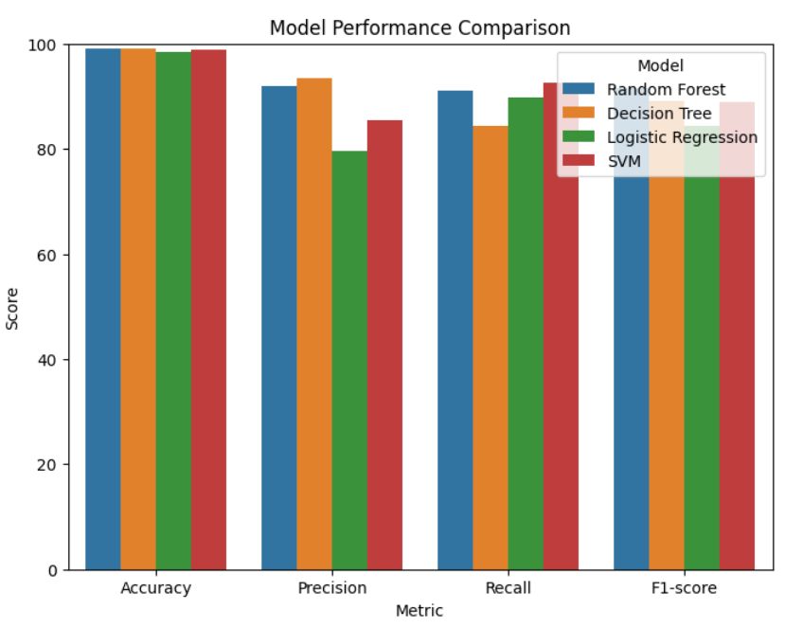
The bar chart shown compares the performance of four machine learning models—Random Forest, Decision Tree, Logistic Regression, and Support Vector Machine (SVM)—using key evaluation metrics: accuracy, precision, recall, and F1-score. As illustrated, the Random Forest classifier consistently leads across all categories, achieving exceptional accuracy and balanced precision and recall values. This strong performance highlights its suitability for network intrusion detection, markedly outperforming the alternatives. The visual comparison reinforces the project’s methodological choice, demonstrating that ensemble models like Random Forest combine reliability and high detection capability, critical for real-time security analytics in operational environments."

Slide 10
THANK YOU

